Slide 1
Arithmetic Word problem Solver
Final Project Discussion
Mude Yashwanth,200050078
Dosapati Jayanth,200260016
Sridevi, 22M0078
27-11-2022

Slide 2
Problem Statement
  Solving arithmetic word problems using NLP and rule based classification
  Eg: Ajay has 5 balls. He buys 7 more balls the how many balls does Ajay have?

Slide 3
Dataset (s)
Illinois SingleOp dataset

Slide 4
Workflow, Architecture, Technique
We use Single Op dataset, containing arithmetic word problems with all four basic operations
Categorize addition-subtraction type word problems into 4 categories(changing,equalizing,combine,compare)
We identify desired operation using keyword-based cues, pattern based-cues, parts of speech based cues.
Change keywords-gives,takes,loses,lost,add,join
Change non-verbal keywords: how,change,sum,away
Combine: all,total,together,altogether

Slide 5
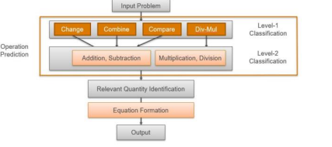
Workflow part-2
We find number of relevant quantities
If relevant quantities are more than 2 then we split question into body and query
Find relevant quantities which are useful for query
Calculate the answer with those relevant quantities and predicted type of operation.

Slide 6
Results
Operation | Total questions | Answers correctly | Accuracy
Addition | 144 | 131 | 90.56
Subtraction | 132 | 122 | 92.45
Multiplication | 80 | 73 | 91.45
Division | 101 | 99 | 97.63
Total | 456 | 425 | 93.421

Slide 7
Results and Analysis
Errors:
If there are 2 quantities which are irrelevant then it computes answer.
Lack of keyword cues: “Misha has 34 dollars. How many dollars does she have to earn to have 47 dollars to buy a dog?” this model doesn’t predict these type of questions
Wrongly identifies POS tag
Overlapped rule based cues
Lack of knowledge on words: pupils

Slide 8
Demo

